Slide 1
Value for Money

Slide 2
“The optimal use of resources to achieve the intended outcomes”
Value for Money - definition
Value for Money is:
Notes:
Definitions dynamic / contested / changing

Slide 3
Value for Money - concept
It is not about:
Doing the cheapest thing
It is about:
Doing the best possible things at the best possible prices
Notes:
Definitions dynamic / contested / changing

Slide 4
Value for Money – The 3 ‘E’s
Economy:
The purchasing of the right inputs at the right price: This is about reducing the cost of resources used for an activity, with regard to maintaining quality.
Efficiency:
The quantity (and quality) of outputs generated from the inputs: this is about increasing output for a given input or minimizing inputs for a given output, with regard to maintaining quality.
Effectiveness:
How well the outputs contribute to desired outcomes
Notes:
Definitions dynamic / contested / changing

Slide 5
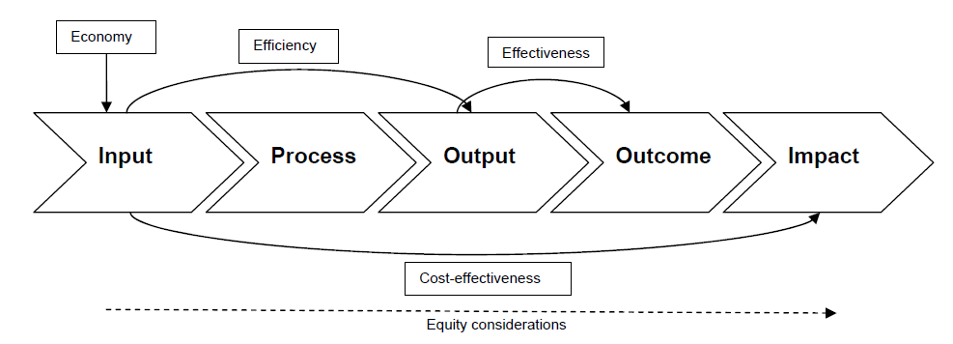
Value for Money: The 3 ‘E’s

Slide 6
Value for Money – The PD form
Q 3.6 | Value for Money (Economy): Briefly describe how the required inputs have been identified and how the GoR procurement procedures will be used to ensure they are obtained cost effectively Provide identified unit cost measures of selected project outputs
Q 3.7 | Value for Money (Efficiency): Briefly explain how the provision and operation of project inputs produce the expected outputs What is the Net Present Value (NPV) and Benefit Cost Ratio (BCR) for this project
Q 3.8 | Value for Money (Effectiveness): - How will it show the outputs meet the project objectives? - Which indicators will you use to demonstrate effectiveness?
Notes:
Definitions dynamic / contested / changing

Slide 7
Economy
Q3.6
Briefly describe how the required inputs have been identified and how the GoR procurement procedures will be used to ensure they are obtained cost effectively
Describe your Procurement Policy

Slide 8
Economy
Q3.6 cont.
Provide identified unit cost measures of selected project outputs:
Choose Output Indicators to use to calculate Unit Costs measures

Slide 9
Effectiveness
Q3.8
How will it show the outputs meet the project objectives?
Describe how you will show your project has been successful

Slide 10
Effectiveness
Q3.8 cont.
Which indicators will you measure to demonstrate effectiveness?
Choose Outcome indicators to demonstrate Effectiveness

Slide 11
Efficiency
Q3.7
Briefly explain how the provision and operation of project inputs produce the expected outputs
Describe how your activities use project inputs to produce outputs

Slide 12
Efficiency
Q3.7 cont.
What is the Net Present Value (NPV) and benefit cost ratio (BCR) for this project?
These show that the value of the project is greater than the costs of the project, through:
Simple Cost Benefit Analysis

