Slide 1
Value for Money

Slide 2
MAKING EVERY RWF COUNT
Notes:
Definitions dynamic / contested / changing

Slide 3
“The optimal use of resources to achieve the intended outcomes”
Value for Money - definition
Good Value for Money is:
Notes:
Definitions dynamic / contested / changing

Slide 4
Value for Money - concept
It is not about:
Doing the cheapest thing
It is about:
Achieving the most with the resources available
Notes:
Definitions dynamic / contested / changing

Slide 5
Where does Value For Money Fit In
Problem Formulation
Concept and Idea Development
Project Design
Project Costing
Project Submission and Approval
Project Implementation
Project Review
PPD Development
PD Development
Project Implementation
PD Orientation
Notes:
Definitions dynamic / contested / changing

Slide 6
Value for Money – The 3 ‘E’s
Project Design
Project Costing
Project Close and Review
Project Implementation
Economy = Inputs (Cost and Quality of labour, materials, time etc.)
Economy is the purchasing of the right inputs at the right price
Measurement= Effectiveness of procurement process
PD Developement
Project Implementation
Notes:
Definitions dynamic / contested / changing

Slide 7
Value for Money – The 3 ‘E’s
Problem Formulation
Project Design
Project Costing
Project Close and Review
Concept and Idea Development
Project Implementation
Efficiency = Inputs+ Processes (Methodology)
Efficiency is the quantity (and quality) of outputs generated from the inputs within predetermined cost and time
Measurement = Project Methodology+Budget+Logframe Milestones
PD Developement
Project Implementation
Notes:
Definitions dynamic / contested / changing

Slide 8
Value for Money – The 3 ‘E’s
Project Close and Review
Project Implementation
Effectiveness = Inputs+processes+outputs ≥ Desired Impact
Effectiveness is the achievement or exceeding of desired impact by achieving desired outcome how well the outputs contribute to desired outcomes
Measurement = Project Logframe+ FONERWA Logframe targets impact , outcomes and milestones achieved
Project Implementation
Notes:
Definitions dynamic / contested / changing

Slide 9
Value for Money – The 3 ‘E’s
Economy = Inputs (Cost and Quality of labour, materials, time etc.)
Economy is the purchasing of the right inputs at the right price
Measurement= Effectiveness of procurement process
Efficiency = Inputs+ Processes
Efficiency is the quantity (and quality) of outputs generated from the inputs within predetermined cost and time
Measurement = Project Methodology+Budget+Logframe Milestones
Effectiveness = Inputs+processes+outputs ≥ Desired Impact
Effectiveness is the achievement or exceeding of desired impact by achieving desired outcome how well the outputs contribute to desired outcomes
Measurement = Project Logframe+ FONERWA Logframe targets impact , outcomes and milestones achieved
Notes:
Definitions dynamic / contested / changing

Slide 10
Value for Money – The PD form
Q 3.6 | Value for Money (Economy): Briefly describe how the required inputs have been identified and how the GoR procurement procedures will be used to ensure they are obtained cost effectively Provide identified unit cost measures of selected project outputs
Q 3.7 | Value for Money (Efficiency): Briefly explain how the provision and operation of project inputs produce the expected outputs What is the Net Present Value (NPV) and Benefit Cost Ratio (BCR) for this project
Q 3.8 | Value for Money (Effectiveness): - How will it show the outputs meet the project objectives? - Which indicators will you use to demonstrate effectiveness?
Notes:
Definitions dynamic / contested / changing

Slide 11
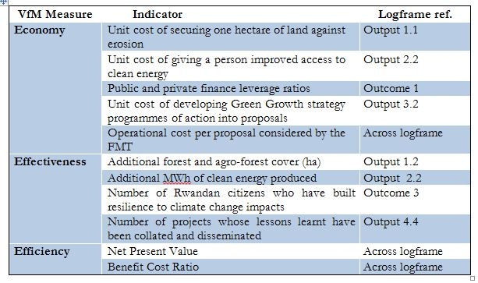
– FONERWA VfM Indicators

